Slide 1
Exploring the Influence of Agriculture on Nigeria’s Economic Growth and Poverty Mitigation in the Rural Area
Analyzing Trends Over A 20 Year Period (2003–2023)

Slide 2
OVERVIEW
Agriculture has been the bedrock of Nigeria’s economy since independence, accounting for over 60% of GDP in the 1960s.
Despite oil boom periods, agriculture still employs over 35% of the labor force and contributes significantly to rural livelihoods.
By leveraging tools like Power BI and SQL, and Excel, this project explores the economic and welfare impact of agriculture over the last two decades, focusing on how it influences GDP growth, employment and population as poverty trends.

Slide 3
OBJECTIVES OF THE PROJECT
To analyze the relationship between agriculture and Nigeria’s economic growth using historical.
To assess how employment in agriculture affects rural welfare and poverty trends.
To determine whether agriculture has become more or less productive over time.
To offer policy recommendations that enhance agriculture's contribution to economic development and human well-being.

Slide 4
Data Sources
All data was gotten from World Bank;
Economic growth and GDP indicators
Agriculture's contribution to GDP,
Rural employment data,
Rural population

Slide 5
Methodology & Tools
Data Analysis Tool
Microsoft Excel (Data Cleaning & Transformation): Excel was used to load and consolidate data from sources like the World Bank, NBS, and CBN. Through Power Query, we cleaned the dataset by fixing formats, removing duplicates, and handling missing values. New insight driven columns such as Growth Contribution Score and Employment Efficiency Ratio etc. were added to enrich the data. This process prepared the dataset for visualization in Power BI and deeper analysis using SQL.

Slide 6
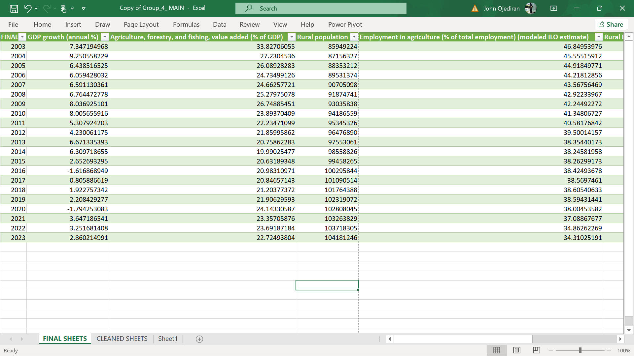

Slide 7
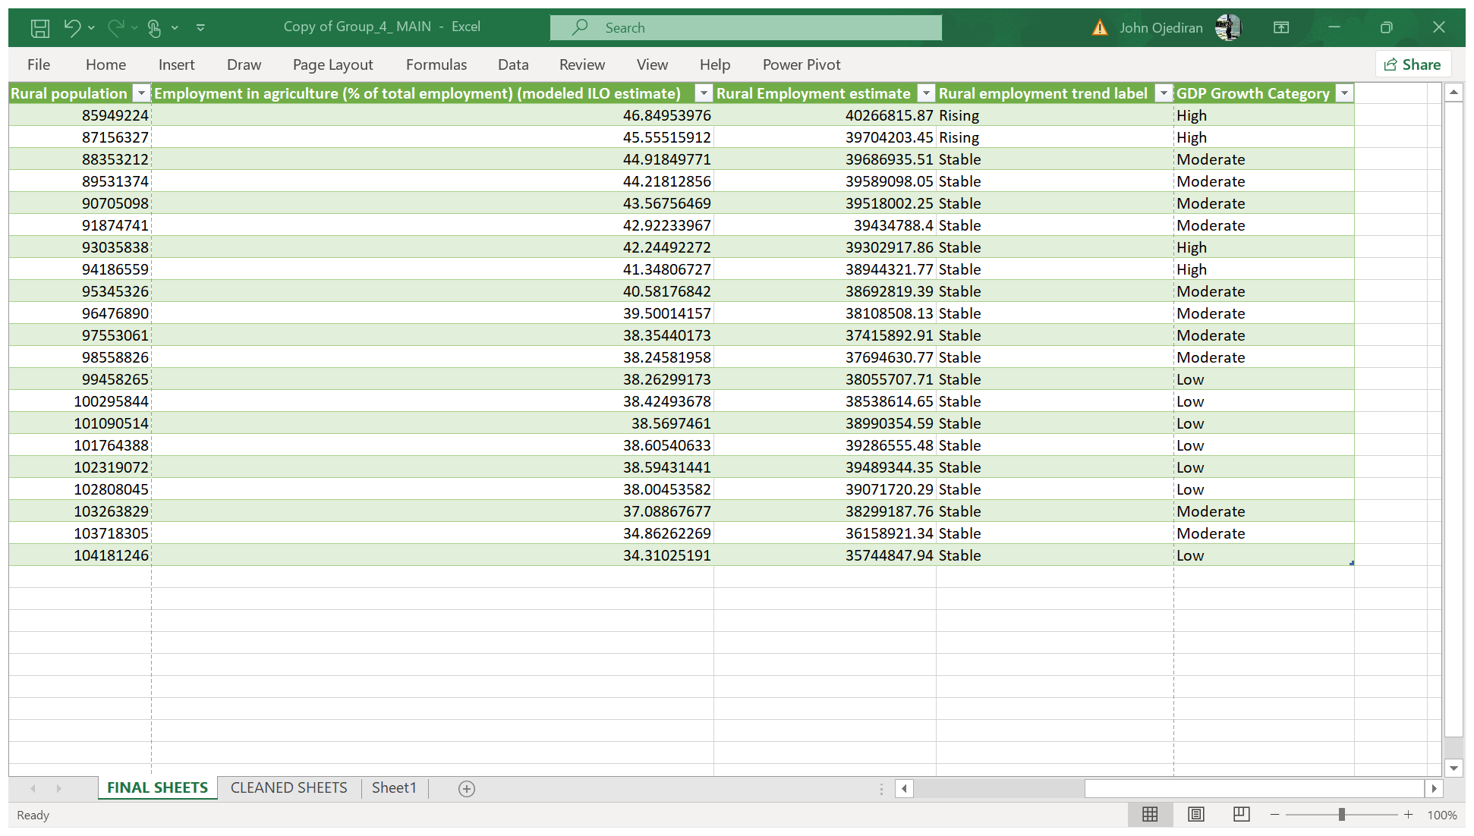

Slide 8
Methodology & Tools
Data Analysis Tool
Microsoft Power BI (Data Visualization): Microsoft Power BI was used to transform the cleaned dataset into interactive visual dashboards that clearly communicated trends and relationships within the data. By importing the Excel file into Power BI, the team created various visualizations such as line charts, combo charts, and scatter plots to show the relationship between agricultural employment, GDP growth, and rural population. Power BI’s DAX language was then used to create custom measures like the Growth Contribution Score, which added deeper analytical insight to the visuals. These dynamic visuals allowed stakeholders to explore the data intuitively and draw meaningful conclusions.

Slide 9
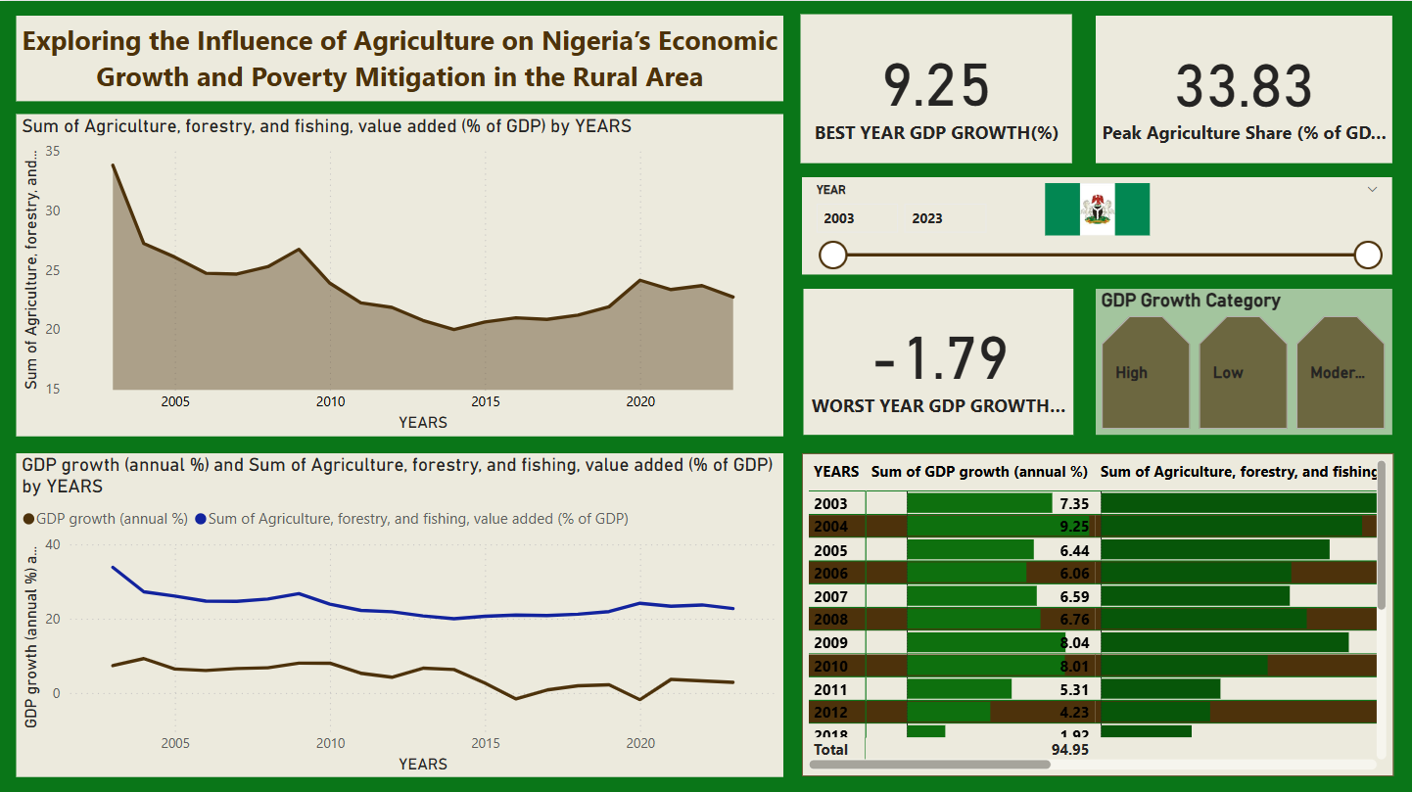

Slide 10
Sum Of Agriculture, Forestry, And Fishing, Value Added (% Of GDP) By Years.
GDP growth (annual %) vs Sum of Agriculture, forestry, and fishing, value added (% of GDP) by YEARS : It depicts how the economy grows or shrinks each year (GDP growth) and how much of that economy comes from agriculture, forestry, and fishing. This shows both the pace of economic development and the role agriculture plays in it over time.
The matrix with conditional formatting represents a year by year comparison of key agricultural and economic indicators, GDP growth, agriculture's share of GDP, rural population, and agricultural employment. By using color gradients, it visually highlights performance levels across these variables, making it easy to spot trends, peak years, and possible imbalances. This allows for a quick understanding of how agriculture and rural dynamics have contributed to Nigeria’s overall economic growth and welfare over time.

Slide 11
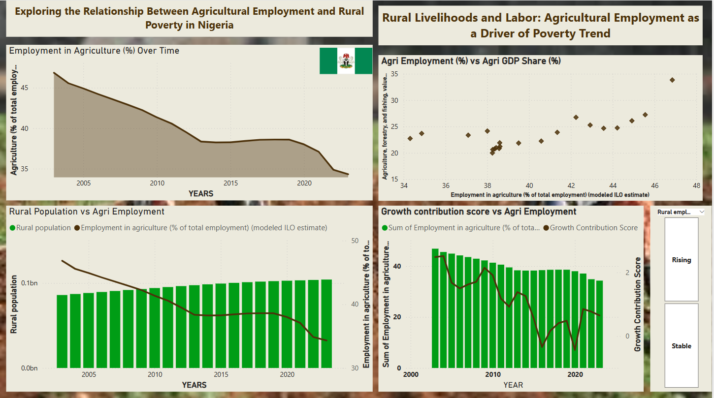

Slide 12
Employment in Agriculture (%) Over Time: The line chart of employment in agriculture (%) over time shows how the share of people working in agriculture changes, often reflecting economic growth, modernization, and potential progress in reducing poverty.
Rural Population vs Agriculture Employment Rate (2003–2023): The line and clustered column chart of rural population and agricultural employment helps illustrate how shifts in rural demographics and farming jobs relate to poverty reduction and declines in both often signal economic transformation, job diversification, and improved living standards in rural areas.
A line and bar chart comparing the Growth Contribution Score and Agricultural Employment (%) illustrates how agriculture's role in economic growth aligns with labor participation in the sector. While the bar chart shows the number of people employed in agriculture over time, the line chart tracks how much agriculture is contributing to overall GDP growth. This visualization helps reveal whether high employment levels correspond with strong economic impact, or if labor is being absorbed without proportional output an important indicator of productivity and rural welfare.
Agri Employment (%) vs Agri GDP Share (%): A scatter map chart showing Agricultural Employment (%) versus Agriculture's Share of GDP (%) highlights the relationship between labor intensity and economic output in the sector. Each point represents a year, and their positions indicate whether high employment levels are matched by a significant contribution to GDP. If many points cluster in the area of high employment but low GDP share, it suggests low productivity, a sign that agriculture is labor heavy but not growth driven. This chart helps visualize efficiency and potential underemployment in the agricultural sector

Slide 13
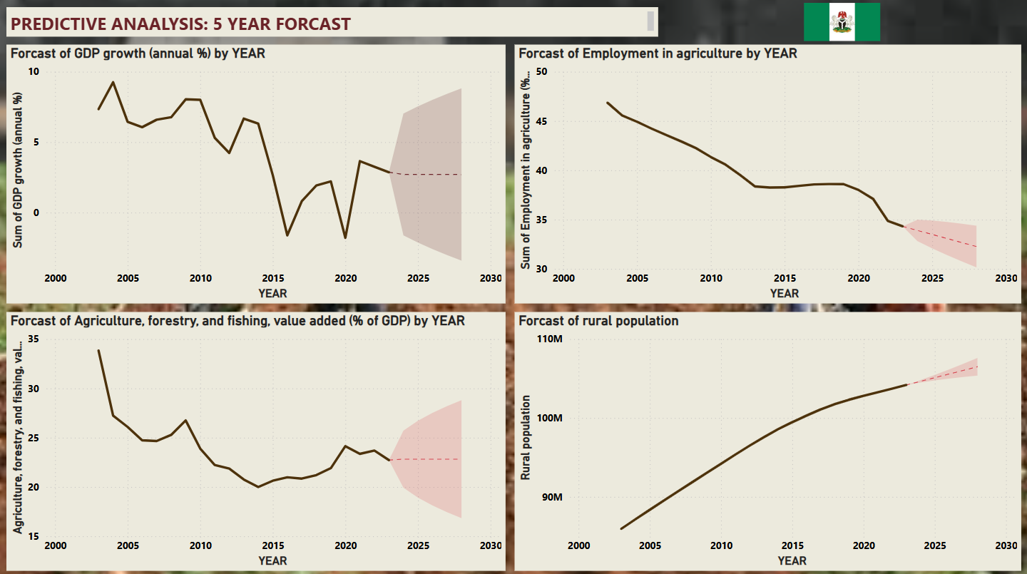

Slide 14
The forecast results present a narrative about Nigeria’s economic and rural landscape over the next five years.
With GDP growth projected to remain constant at 2.70%, the economy appears stable but not dynamic. This steady pace of growth suggests that while the country may avoid contraction (total value of goods and services it produces is falling, rather than growing), it may also struggle to generate the kind of economic momentum needed to reduce poverty significantly or transform the livelihoods of its citizens, especially those in rural areas.
At the same time, agriculture's contribution to GDP is expected to hold steady at 22.82%. This indicates that agriculture will continue to play a notable role in the economy, but not a growing one. The sector appears to be neither shrinking nor expanding in its relative importance, raising concerns about stagnation. Without innovation, policy shifts, or major investment, agriculture risks becoming a static pillar in a changing economic environment.
More concerning is the divergence between population and employment trends. The rural population is forecasted to continue increasing, which points to rising pressure on land, infrastructure, and basic services in rural communities. However, employment in agriculture is predicted to decline over the same period. This imbalance could signal a deepening vulnerability where more people live in rural areas but fewer are engaged in agricultural work, either because of declining opportunities, outmigration, or lack of modernization in the sector.

Slide 15
Recommendation Based On These Forecast
Together, these forecasts suggest a slow-moving economy anchored by a steady yet underperforming agricultural sector, with growing rural populations facing diminishing employment prospects. If left unaddressed, this disconnect could contribute to persistent rural poverty, underemployment, and social strain. The findings reinforce the urgent need for targeted interventions that boost agricultural productivity, diversify rural livelihoods, and link economic growth more directly to improvements in human welfare.

Slide 16
Methodology & Tools
Data Analysis Tool
SQL
In this project, SQL served as the analytical engine behind the scenes, enabling us to interact directly with the dataset in a flexible and scalable way. By using SQL, we were able to filter, group, and sort the data to uncover key patterns and relationships, such as how agriculture’s share of GDP compares to GDP growth, or how rural employment shifts over time.

Slide 17
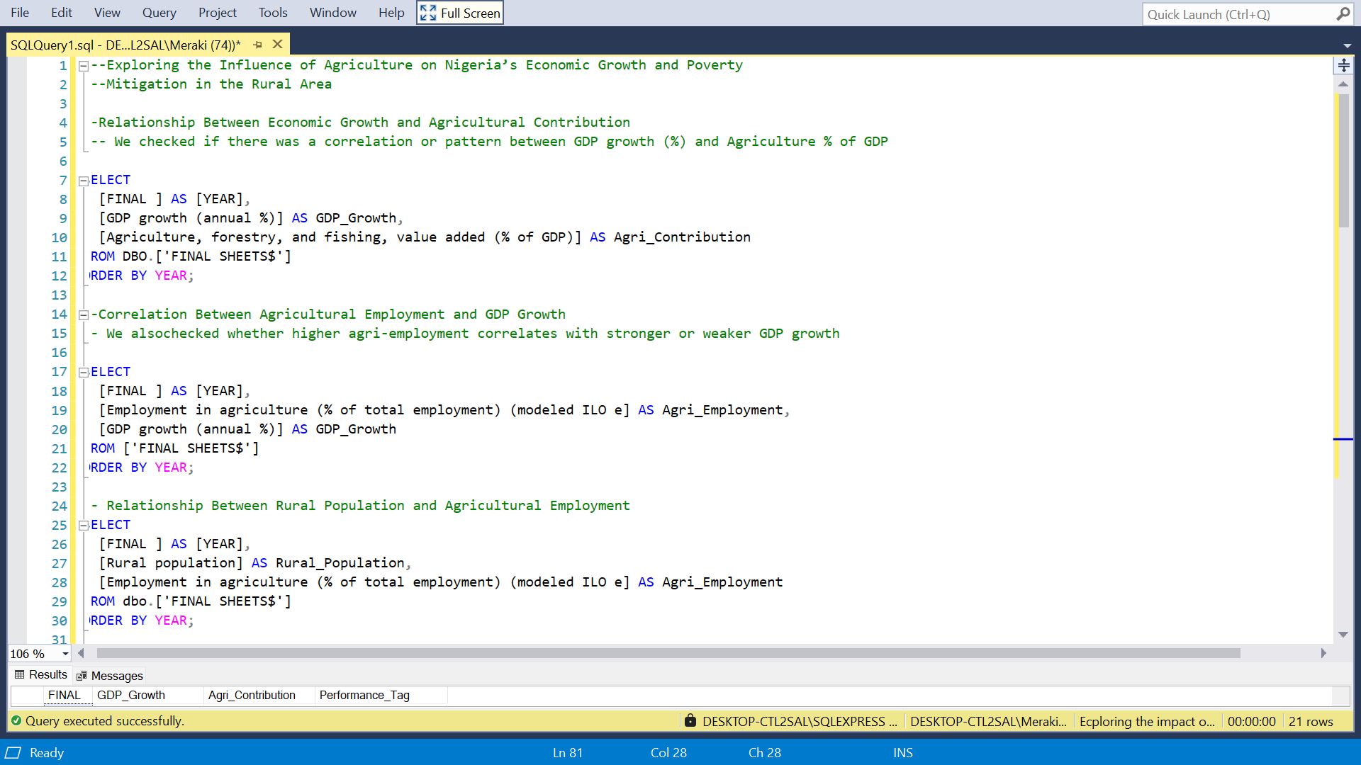

Slide 18
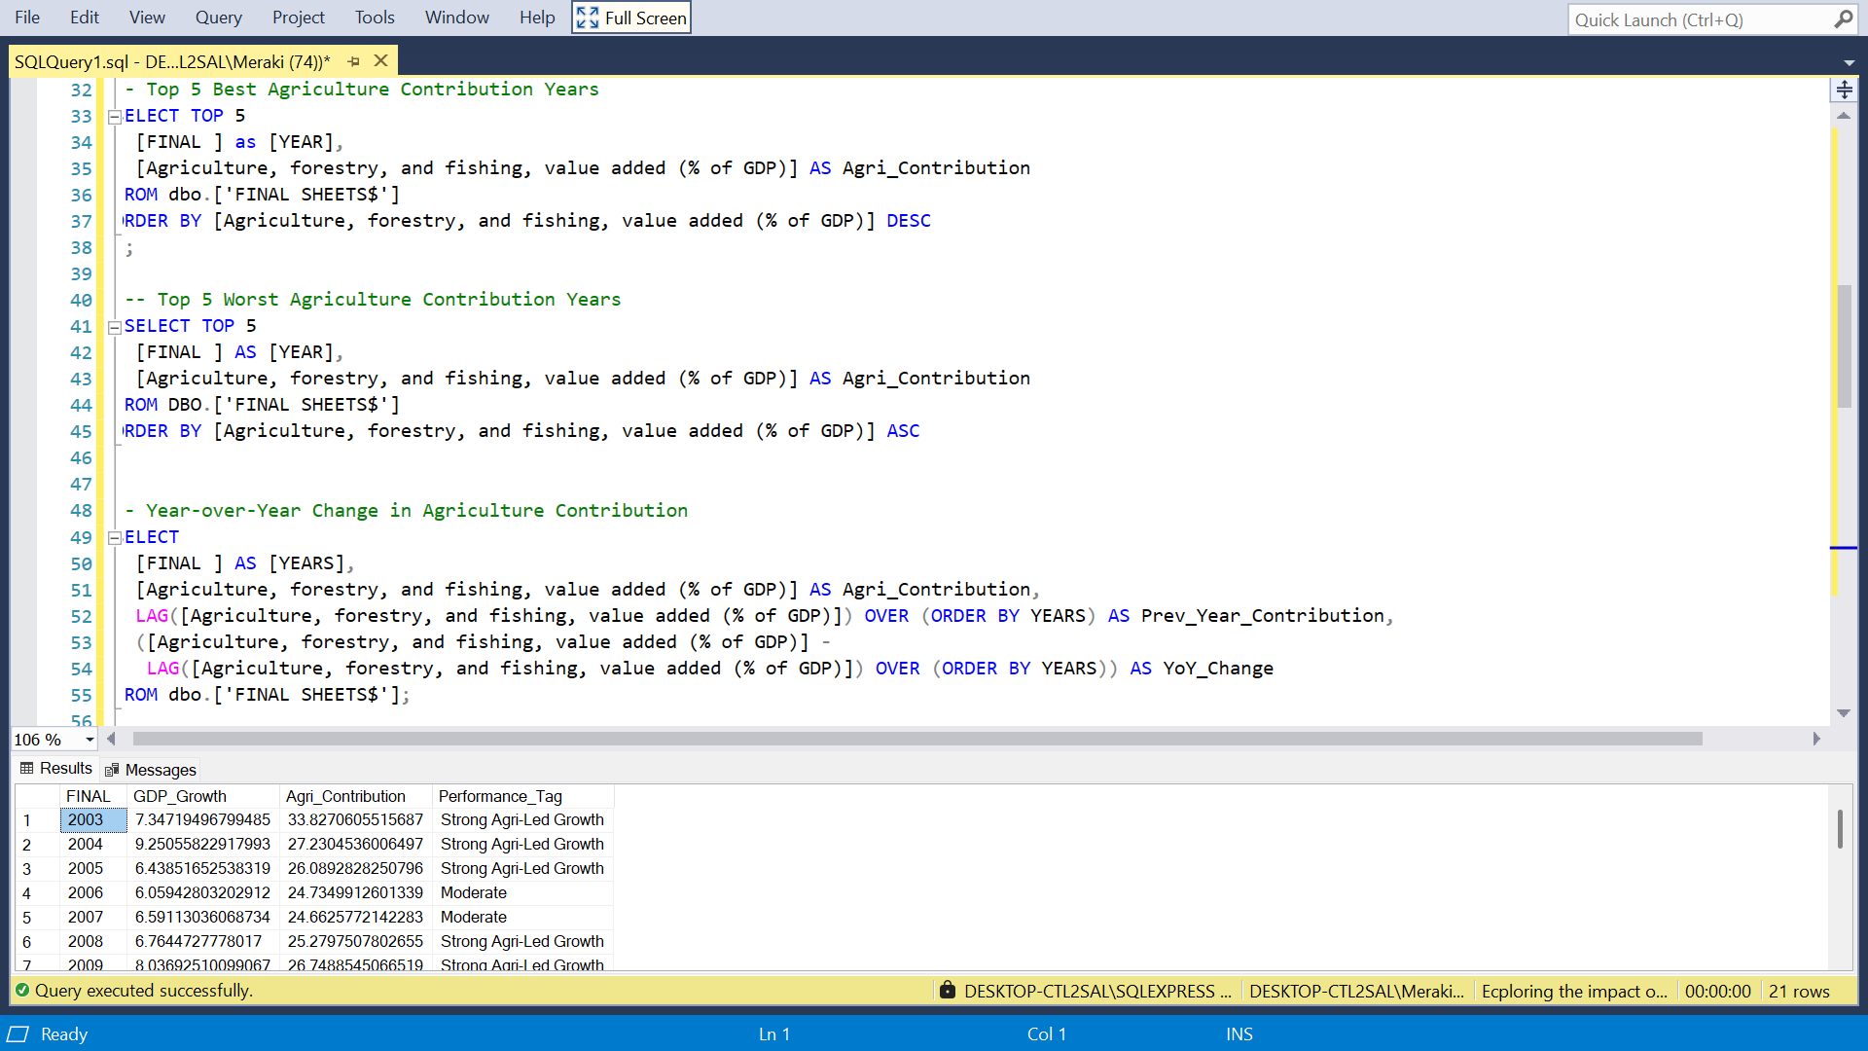

Slide 19
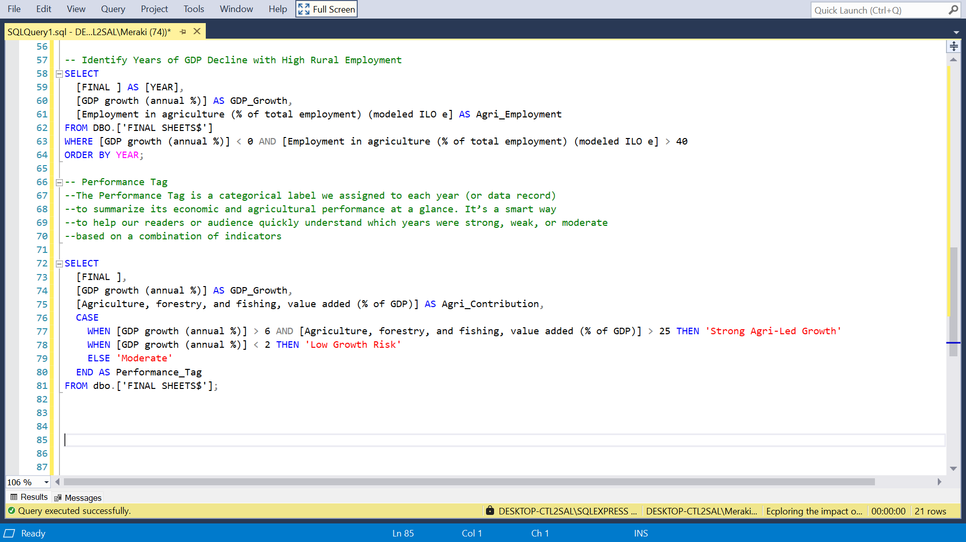

Slide 20
THANK YOU!
GROUP MEMBERS:
AKINYEMI HAMIDAT
OLANLEYIN MONSURAT TOPE
AHMED ABEEB
OJEDIRAN JOHN JR.

